Slide 1


Data Science and Machine Learning in “R” & “Python” Project Presentation
Group A ,
Batch 2
IIM Raipur
Date : 26th July 2020

Slide 2

We would like to express our gratitude towards Dr. Sumeet Gupta and Dr. Gopal Sir.
ACKNOWLEDGEMENT
Participants:
Abhilasha Singh
Atharv Deshpande
Dolita Kumari
Jithu Balakrishnan
Prashant Nanda
Saurabh Verma

Slide 3

1. Objective 2. Overview of Datasets 3. Analytical Tool s 4. Use Case – A a. Multiple Regression & Data Mining b. Data Visualization 5. Use Case - B a. Logistic Regression &Predictive Model b. Multinomial Naïve Bayes &Predictive Model c. Decision Tree & Predictive Model d. Data Visualization & Preprocessing
AGENDA

Slide 4

Objectives of The Study
To design predictive model for healthcare claims dataset using R studio and tools
To generate heatlhcare claims analytical report across pre-defined KPI for executives using Tableau
To identify and predict fake news using logistic regression, naive bayes and decision tree classifications using Python
To perform data visualization and pre-processing using fake data

Slide 5

Datasets

Slide 6

Overview of Datasets
Healthcare Claims Datasets
Fake News and Real News Datasets
Used by healthcare providers ( Hospitals, physicians) and Healthcare insurance
Datasets give information around trends in claims cost and factors impacting claims cost
Claims Cost Distribution study across geography, disease, age , gender, HCC risk score
More than 10000 records for patient and claims data has been analyzed
Used by News Agencies Social media
Datasets give information about fake news and Real news trends .
Fetching News and study in the terms of Government News, Political News, US News etc.
Approx 50000 records for Fake and Real News data has been analysed
6

Slide 7
Analytical Tools and Methodology

Slide 8
Overview Of Analytical Tools & Methodology
R Package & R Studio
Python
Multiple Linear Regression and Prediction Model
Data Mining Approach
Linear Regression and Predictive Model
Multinomial Naïve Bayes and Predictive Model
Decision Tree and Predictive Model
Data Visualization And Preprocessing
Tableau
Claims Analyticall Dashboard for healthcare payers
8

Slide 9
Use Case A – Healthcare Claims Datasets

Slide 10
Multiple Linear Regression and Data Mining Approach
Problem Statement - The U.S. healthcare industry are under pressure to cut down healthcare claims cost
To predict healthcare claims cost based on multiple independent variable
Dependent Variable – Healthcare Claim Cost
Independent Multiple Variables are
Age - Rise in aging population will increase healthcare claim cost
Length of Patient Stay In Hospital - More hospital stay results in more cost
Disease Type
Gender
Chronic Disease
Providers Place of Service - Cost in emergency will be higher as compared to clinic
Preventable Disease
Readmission Rate - More case of readmission more will be claims cost
HCC Risk Score - Higher the HCC risk score , higher will be claims cost
Per Member Per Month Cost – Higher PMPM cost , less saving for providers & more cost

Slide 11
R Code Description & Outcome
Prediction Model Formula –
Predicted Healthcare Cost = y + a1 *X1 + a2 *x2 + a3 *X3 + _______ + an *Xn
= 3035.9633 + Age *0.012760 + Gender * 0.000942 + HCC Risk Score *0.321614 + PMPM Cost * 0.54820
Statistical Outcome
Data Insight
Residual standard error: 1462 on 10220 degrees of freedom
Multiple R-squared: 0.004289
Adjusted R-squared: 0.001464
F-statistic: 1.518 on 29 and 10220 DF
p-value: 0.03682
Claims cost of Male estimated to be 96.8932 higher than female
Claims cost of Chronic disease 3 is 8.6 times higher than chronic disease 1,2, 4, and 5
Claims Cost of Physician office is 64 times higher than Ambulatory Services and 36 times higher for Hospital .
Difference between Hospital and Physician Office Claim Cost is 25
Training Model Outcome
Conclusion
ME RMSE MAE MPE MAPE
Test set -0.0000000000000402339 1459.769 1252.135 -77.33895 106.3405
Model is best fitted model as R2 value is between o and 1 and Positively Related
with less data variability from Observed Least Square line
RMSE value of both training and test model is approximately similar that
indicates accuracy of best fitted model
Testing Model Outcome
ME RMSE MAE MPE MAPE
Test set -4.568831 1460.183 1253.124 -77.75798 106.7345

Slide 12
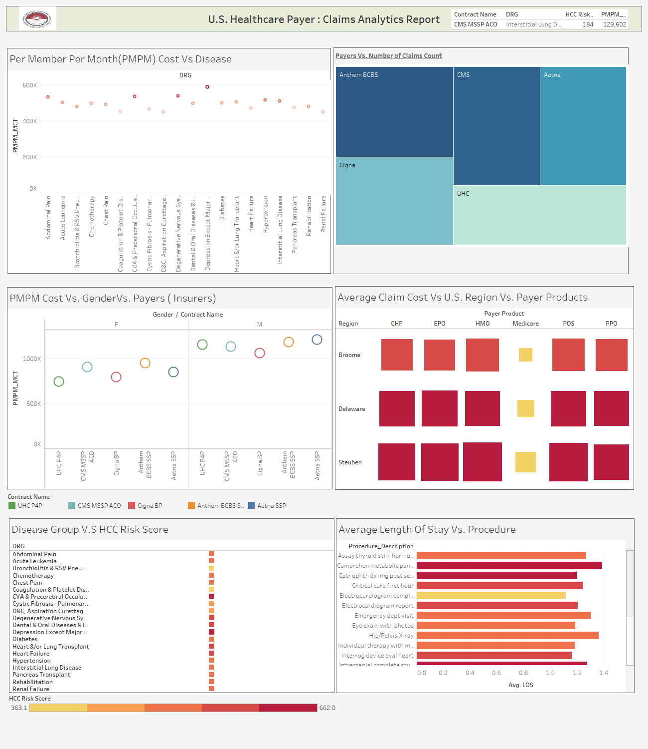
Healthcare Claims Analytical Dashboard

Slide 13
Use Case B –Fake_News and Real_news Datasets

Slide 14
Project Overview
In this Project, we classify news headlines as “fake" or “real." we build and compare several standard classifiers: Logistic Regression ,Multinomial Naive Bayes, and a Decision Tree.
Fake news, also known as junk news, pseudo-news, alternative facts or hoax news, is a form of news consisting of deliberate disinformation or hoaxes spread via traditional news media (print and broadcast) or online social media. Digital news has brought back and increased the usage of fake news, or yellow journalism.
Our pedagogical approach emphasizes having analyze the models that we build. In particular, we obtain keywords whose presence and absence most strongly indicates that a headline is "fake" or "real“ with indexing 0 and 1. We explore the connection among Logistic Regression ,Multinomial Naive Bayes, and a Decision Tree.
SOFTWARE we use-PYTHON, ANACONDA (SPYDER)

Slide 15
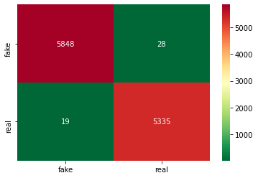
Linear Regression and Predictive Model
Logistic regression is a predictive analysis. Logistic regression is used to describe data and to explain the relationship between one dependent binary variable and one or more nominal, ordinal, interval or ratio-level independent variables.
A Confusion Matrix is a table that is often used to describe the performance of a classification model (or “classifier”) on a set of test data for which the true values are known. It allows the visualization of the performance of an algorithm.
Statistical Outcome
Confusion matrix_Logistic Regression:
[[5848 28]
[ 19 5335]]
Logistic Regression accuracy: 99.58%
Logistic Regression accuracy score: 0.9958147818343722

Slide 16
Classification Method
A Classification report is used to measure the quality of predictions from a classification algorithm.
The precision will be "how many are correctly classified among that class"
The recall means "how many of this class you find over the whole number of element of this class"
The f1-score is the harmonic mean between precision & recall
The support is the number of occurence of the given class in dataset
Statistical Outcome
Classification_Report_Logistic Regression:
precision recall f1-score support
fake 1.00 1.00 1.00 5876
real 0.99 1.00 1.00 5354
accuracy 1.00 11230
macro avg 1.00 1.00 1.00 11230
weighted avg 1.00 1.00 1.00 11230
Classification Method

Slide 17
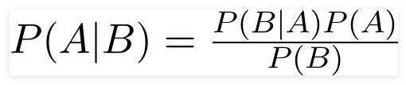
Multinomial Naïve Bayes and Predictive Model (1/2)
A Naive Bayes classifier is a probabilistic machine learning model that’s used for classification task. The crux of the classifier is based on the Bayes theorem.
Using Bayes theorem, we can find the probability of A happening, given that B has occurred. Here, B is the evidence and A is the hypothesis. The assumption made here is that the predictors/features are independent. That is presence of one particular feature does not affect the other. Hence it is called naive.
Statistical Outcome
Naive Bayes Accuracy: 95.11%
Naive Bayes Accuracy_score : 0.951113089937667

Slide 18
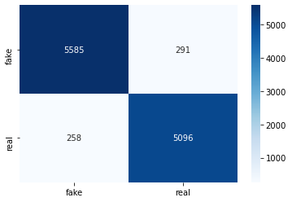
Multinomial Naïve Bayes and Predictive Model (2/2)
Statistical Outcome
Classification Report
Confusion Matrix
Classification_Report_ Naive Bayes:
precision recall f1-score support
fake 0.96 0.95 0.95 5876
real 0.95 0.95 0.95 5354
accuracy 0.95 11230
macro avg 0.95 0.95 0.95 11230
weighted avg 0.95 0.95 0.95 11230
Confusion matrix_Naive Bayes:
[[5585 291]
[ 258 5096]]

Slide 19
Decision Tree and Predictive Model (1/2)
The decision tree classifier creates the classification model by building a decision tree.
Each node in the tree specifies a test on an attribute, each branch descending from that node corresponds to one of the possible values for that attribute
Statistical Outcome
Decision Tree accuracy: 99.48%
Decision Tree accuracy score: 0.9948352626892253

Slide 20
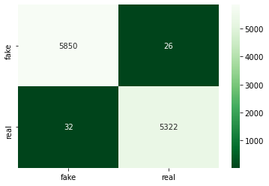
Decision Tree and Predictive Model (2/2)
Statistical Outcome
Classification Report
Confusion Matrix
Classification Report Decision Tree:
precision recall f1-score support
fake 0.99 1.00 1.00 5876
real 1.00 0.99 1.00 5354
accuracy 1.00 11230
macro avg 1.00 1.00 1.00 11230
weighted avg 1.00 1.00 1.00 11230
Confusion matrix Decision Tree:
[[5850 26]
[ 32 5322]]

Slide 21
Conclusions
Predicted AI/ML Model Accuracy Achievement
Logistic Regression model accuracy achieve d is around 99.58%
Multinomial Naive Bayes model accuracy is around 95.11%
Decision Tree Classifications accuracy is around 99.55%

Slide 22



THANK YOU
9028768161
dolita03@gmail.com

